Slide 1

MedConfer - Synopsis
MedConfer
i3i Hackathon 2021

Slide 2

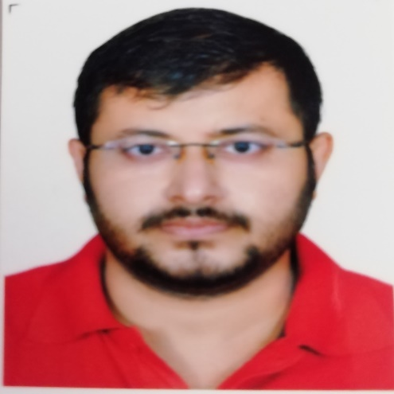



Meet Our Team
MedConfer
Business Analyst
Scrum master
Prachi Dube
Idea Initiator & Solution Architect
Soumik Das
Team Contributor
Team Contributor
Anil Arepelli
Nihar Nayak
Neha Vashishth

Slide 3
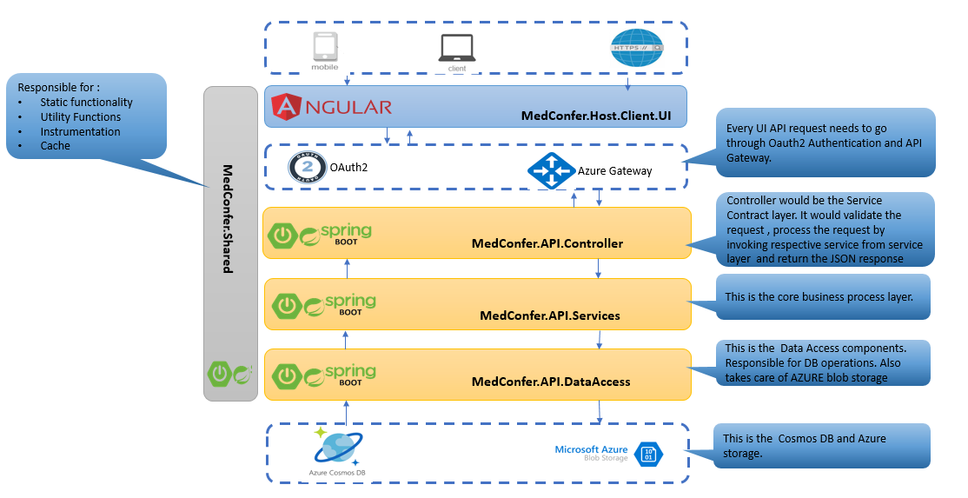
MEDCONFER - SOLUTION OVERVIEW
MedConfer
Objectives
Benefits / Results
Process / GUI
The application will aim to reduce the chaos and provide process to the hospitalization procedure. It will help to :
Compare hospitalization charges as well as doctor charges in different hospitals.
Facility to compare surgery /operation reviews for any particular surgery/disease and book appointment with doctor as well as book Hospital rooms in case of surgery
Timely reminder of health check-ups/post medication after surgery on mobile of individuals by maintaining a centralized patient repository
People who are planning for treatment and have no idea how to compare cost, which doctor is best for a particular disease in a given area or if they want to be treated under a particular doctor, all these issues will be addressed in this app.
Continuous monitoring of health status with timely health check ups will allow to act on issues proactively.
Post hospitalization medication and timely check ups reminders by maintaining centralized repository of patients on the app.
Centralized application for monitoring/analyzing hospitalization data
Implementing digitization in health care sector as practiced in all other sectors like online payment, hotel booking, ticket booking , banking etc.
Solution
Getting hospital data from various hospitals , analyzing them and depicting the necessary data on web page.
Creating the UI and representing the data

Slide 4







Use Case
MedConfer
He found MedConfer app which is giving details about Hospitals and their Top 5 doctors with statistics to compare and choose. It also provides last 6 months data and list of Insurance providers associated with the hospital.
John has gone through number of hospital websites but does not find any such application that can compare hospitalization charges and other facilities
After he decides the hospital and doctor that he’d like to get the treatment from, he is able to book the appointment and room in hospital using the MedConfer app.
John’s father is ill with dengue fever
Hospitalization process is smooth, and treatment starts promptly since the hospital is in the network of hospitals of John’s Medical Insurance Provider
John’s father receives notifications for timely health check up after treatment.
John’s father returns home with least number of hospitalization days

Slide 5




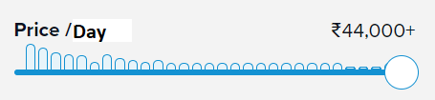


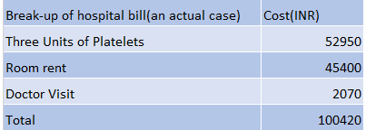










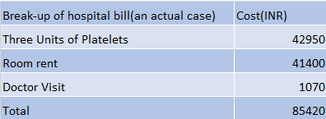
Contact us
1800 3456 6789
Treatment For:
Dengue Fever
10/06/2021 10:30 AM
MedConfer
helpcare@gmail.com
Price / Day
155 Cases handled in last 6 months and
having 89%success rate
Last 6 Months Trend
Dr Ganesh
Insurance Providers
Dr Mahesh
Apollo
KIMS
Dr Ravi
Average Expenses(INR)
54000
44000
Dr Indira
Book your appointment >
Mon- Fri
(09:30 AM - 04:30PM)
Book your room >
No of Dengue cases
232
202
Success Rate (%)
96
94
No of 5* Ratings
145 Cases handled in last 6 months and
having 87%success rate
Successful Claims
96
95
Dr Aftab
Insurance Providers
Dr Akhil
No. of Hospitalization days
3
4
Dr Anil
Book your appointment >
Dr Vikram
No of 5* Ratings
123
141
Book your room >
Mon- Fri
(09:30 AM - 04:30PM)

Slide 6
Thank You!

